Slide 1
Lecture 2 Hamming Codes Part 1 – Binary Part 2 – Decimal
We will also use week 2 tutorial slots to cover these materials

Slide 2
Part 1: Hamming Codes (binary)
A set of single error correcting codes invented by Richard Hamming in 1950
Hamming worked at Bell Lab and frustrated with punch cards input errors, …
One of Hamming’s famous quotes
“It is better to solve the right problem the wrong way than to solve the wrong problem the right way”

Slide 3
An “irrelevant” story – King and his wines problem
n barrels of wines, one of them is poisoned !
Can’t tell which one unless taste it ☹
Poison is very strong – one tiny drop kills !
Poison works slowly – a full month to die !
What should king do?
Scheme 1:
use 1 tester, tastes one by one (need n months in the worst case)
Scheme 2:
use n testers, taste
all bottles at same time (need one month)
----------------------------------
Can we design a scheme, taking only 1 month time, and O(log n) testers?

Slide 4


Solve King and his wines problem by using binary search idea
000 001 010 011 100 101 110 111
1
0xx
2
x0x
3
xx0
All died
Tester 1 and 3 died
All alive

Slide 5
Hamming(7,4) Code (7=length of codeword; 4=length of real data)
Instead of using a single parity bit, we apply a similar idea used in the king and wines problem; multiple parity check bits are added, one per each different half
Take binary code of length 4 as an example, d₁d₂d₃d₄, we add 3 parity bits p₁p₂p₃ cover three different part of data as the following.
Bit No. | 1 | 2 | 3 | 4 | 5 | 6 | 7
 | p₁ | p₂ | d₁ | p₃ | d₂ | d₃ | d₄
p₁ | yes | no | yes | no | yes | no | yes
p₂ | no | yes | yes | no | no | yes | yes
p₃ | no | no | no | yes | yes | yes | yes

Slide 6
Encoding Hamming(7,4) Code
The three parity bits are worked out as follows:
p₁ = (d₁+d₂+d₄) mod 2 (make p₁d₁d₂d₄,
p₂ = (d₁+d₃+d₄) mod 2 p₂d₁d₃d₄, and p₃d₂d₃d₄
p₃ = (d₂+d₃+d₄) mod 2 have even number of 1s)
e.g. input data, d₁d₂d₃d₄ = 1011
p₁ = (1+0+1) mod 2 = 0
p₂ = (1+1+1) mod 2 = 1
p₃ = (0+1+1) mod 2 = 0
Encoded codeword p₁p₂d₁p₃d₂d₃d₄ = 0110011

Slide 7
Decoding Hamming(7,4) Code
We need to define a syndrome vector (s₁,s₂,s₃):
s₃ = (p₁+d₁+d₂+d₄) mod 2
s₂ = (p₂+d₁+d₃+d₄) mod 2
s₁ = (p₃+d₂+d₃+d₄) mod 2
Simple case: If no error, (s₁,s₂,s₃) =000, i.e. 3 parity checking all passed
Otherwise: when (s₁,s₂,s₃) ≠ 0, there is an error, moreover the syndrome vector indicates the error position!
e.g. 0110011 is transmitted into 0110010
we get (s₁,s₂,s₃) =111, this indicates an error occurred at 7th position.

Slide 8
Decoding Hamming(7,4) Code cont. More examples
s₃ = (p₁+d₁+d₂+d₄) mod 2
s₂ = (p₂+d₁+d₃+d₄) mod 2
s₁ = (p₃+d₂+d₃+d₄) mod 2
0110011 is transmitted into 0110111 (d₂)
(s₁,s₂,s₃) =101, an error at 5th position.
0110011 is transmitted into 0010011 (p₂)
(s₁,s₂,s₃) =010, an error at 2nd position.
0110011 is transmitted into 0110000 (d₃d₄)
(s₁,s₂,s₃) =001, an error at 1st position, wrong! Double errors can’t be detected!

Slide 9
Hamming(7,4) Code - Summary
For every given 4 bits binary messages, we add 3 parity bits (ref. slide 6), together 7 bits codeword will be transmitted.
When receive a codeword, we work out syndrome vector (ref. slide 7) which indicates the position of single error, 0 vector means no error.
3 redundant bits can represent 8 states (2³=8) which are, no error, and 7 single error positions.

Slide 10
Hamming(8,4) Code
Extended from Hamming(7,4) code, by adding an extra parity bit on all 7 bits:
p₄ = (p₁+p₂+p₃+d₁+d₂+d₃+d₄) mod 2
e.g. p₁p₂d₁p₃d₂d₃d₄ = 0110011, p₄= 0
What does this extra bit do?
Suppose p₁p₂d₁p₃d₂d₃d₄p₄ = 01100110 is transmitted into 01100000 (2 errors, the example given in slide 7). We get (s₃,s₂,s₁) =001 which indicates an error at 1st position. But the parity checking on all 8 bits is 0, which indicates no error or even number of errors. Therefore, we can conclude that a double error must have occurred.

Slide 11
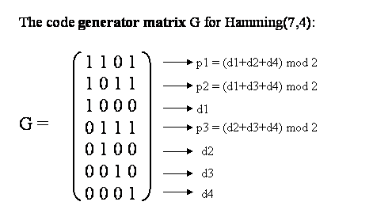
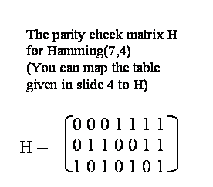
Another way to look at encoding/decoding Hamming Codes (a mathematical view) Introduce two matrices: generator matrix G and parity check matrix H

Slide 12
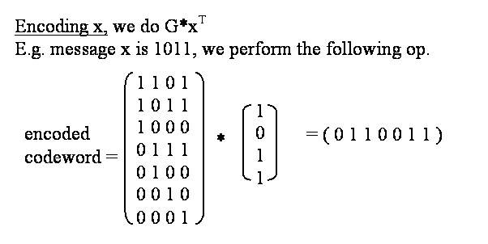
Encoding procedure is simply a matrix multiplication

Slide 13
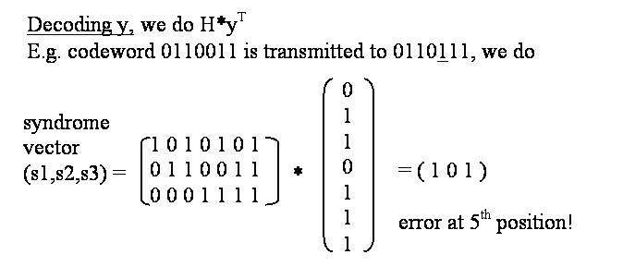
Decoding procedure is also a matrix multiplication

Slide 14
Summary on Part 1
Hamming(7,4) Code
single error correcting code
4 binary bits + 3 extra parity bits
How to encode in Hamming(7,4)
p₁ = (d₁+d₂+d₄) mod 2, p₂ = (d₁+d₃+d₄) mod 2, p₃ = (d₂+d₃+d₄) mod 2
Encoded codeword p₁p₂d₁p₃d₂d₃d₄
How to correct an error in Hamming(7,4)
s₃ = (p₁+d₁+d₂+d₄) mod 2 s₁ s₂ s₃ = 000 means no error
s₂ = (p₂+d₁+d₃+d₄) mod 2 otherwise convert s₁ s₂ s₃ to decimal n
s₁ = (p₃+d₂+d₃+d₄) mod 2 the error is at n^{th} position
Hamming(8,4) Code – adding an extra parity check bit for all 7 bits, double error detecting

Slide 15
Part 2: Hamming Codes (from binary to decimal)
What is the major difference between binary and decimal?
BINARY - Two states only need to figure out the position of the errors
DECIMAL - More than two states – need to know not only the position of the errors but also the magnitudes of the errors.

Slide 16
Back to ISBN Numbers
(d₁ + 2d₂ + 3d₃ + …+ 9d₉) mod 11 = d₁₀
d₁₀ is the ‘parity checking’ digit
is called weighted check sum
Why can’t we simple do the following?
(d₁ + d₂ + d₃ + …+ d₉) mod 11 = d₁₀
E.g. 123456789 – 1
Mistake 223456789 – 1
What if 123456798 – 1 ? transposition error

Slide 17
Back to Credit Card Numbers
Use an example to illustrate Luhn check:
4552 7204 1234 5698 first, double every alternate number
-> 85(10)2 (14)204 2264 (10)6(18)8 if result >=10, take away 9
-> 8512 5204 2264 1698 now use this to do mod 10
Add up all the digits in this new number. If the final total is perfectly divisible by 10, then the credit card number is valid (Luhn check is satisfied), else it is invalid.
Same question – why can’t we just simple add all numbers up?
Another question – mod 11 and mod 10, which is better?

Slide 18
A New Problem: given 8 digits student id numbers How to add 2 extra digits in order to correct single error?
Recall the ISBN code example, a weighted check sum method is used to detect single error.
d₁₀ = (d₁ + 2d₂ + 3d₃ + …+ 9d₉) mod 11
Use similar idea, for 8 digits input d₁d₂…d₈
We generate 2 new digits in the following way:
d₉ = (2d₁ + 3d₂ + 4d₃ + …+ 9d₈) mod 11
d₁₀ = (8d₁ + 7d₂ + 6d₃ + …+ 1d₈) mod 11
This is called 10-ary Hamming code (Hamming(10,8))
(from page 76, example 7.12 R. Hill's book)

Slide 19
An Example of Encoding
Let Input = x,
encoded(x) = x*G (mod 11)
E.g. x = 06102713,
d₉ = (2*0+3*6+4*1+5*0+6*2+
7*7+8*1+9*3) mod 11
= (18+4+12+49+8+27) mod 11
= 118 mod 11 = 8
d₁₀ = (8*0+7*6+6*1+5*0+4*2+
3*7+2*1+1*3) mod 11
= (42+6+8+21+2+3) mod 11
= 82 mod 11 = 5
So, encoded x is 0610271385
(matrix multiplication see next slide)
The generator matrix G for 10-ary Hamming(10,8)
1 0 0 0 0 0 0 0 2 8
0 1 0 0 0 0 0 0 3 7
0 0 1 0 0 0 0 0 4 6
0 0 0 1 0 0 0 0 5 5
0 0 0 0 1 0 0 0 6 4
0 0 0 0 0 1 0 0 7 3
0 0 0 0 0 0 1 0 8 2
0 0 0 0 0 0 0 1 9 1
G =
This is called I₈ identity matrix

Slide 20
Encoding by Generator Matrix
x = 06102713
y is encoded x
1 0 0 0 0 0 0 0 2 8
0 1 0 0 0 0 0 0 3 7
0 0 1 0 0 0 0 0 4 6
0 0 0 1 0 0 0 0 5 5
0 0 0 0 1 0 0 0 6 4
0 0 0 0 0 1 0 0 7 3
0 0 0 0 0 0 1 0 8 2
0 0 0 0 0 0 0 1 9 1
y = (0 6 1 0 2 7 1 3) *
= (0 6 1 0 2 7 1 3 8 5)

Slide 21
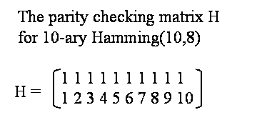
Decoding (Parity Check Matrix)
1st row says, the sum of all digits mod 11 must be 0
2nd row says, the weighted sum mod 11 must be 0
All codewords generated by G must follow these conditions.
Check 06102713 85 :
(6+1+2+7+1+3+8+5) mod 11 = 33 mod 11 = 0
(2*6+3*1+5*2+6*7+7*1+8*3+9*8+10*5) mod 11
= 220 mod 11 = 0

Slide 22
How to Decode
Calculate syndromes
s1 = (d₁ + d₂ + d₃ + …+ d₁₀) mod 11
s2 = (d₁ + 2d₂ + 3d₃ + …+ 10d₁₀) mod 11

Slide 23
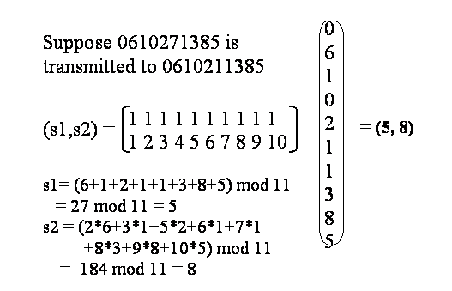
How to Decode
Syndromes (s1, s2)
can have 3 cases
s1=s2=0
no errors
s1≠0, s2≠0
a single error
(s2/s1) mod 11
gives the error position
s1 is the error magnitude
Otherwise double errors

Slide 24
Why does (s2/s1) mod 11 give the error position ? Why does s1 give the error magnitude ?
Suppose when transmitting (x₁, x₂, …x₁₀), , a single error occurred at the position j and the error magnitude is k,
what we received is (x₁, … x_{j}+k, …x₁₀),
(1) because (x₁ +…+x₁₀) mod 11 = 0, so
s1 = (x₁ +…+x₁₀ + k) mod 11 = k
That is, s1 = k, it is the error magnitude
(2) because (1*x₁ + 2*x₂+…+10*x₁₀) mod 11 = 0, so
s2 = (1*x₁ +… j*(x_{j}+k) +…+10*x₁₀) mod 11 = j*k mod 11
That is, s2 = j*k mod 11.
Then j = s2/k mod 11 = s2/s1 mod 11

Slide 25
Cont. 10-ary Hamming(10,8) Code Decoding Example from Slide 23
Suppose 0610271385 is transmitted to 0610211385. s1= 5, and s2 = 8
under modulo 11:
s2/s1 =8/5 = 8*5⁻¹ =8*9 = 6
=> error at 6th digit with magnitude 5
so, the corrected code should be
(0,6,1,0,2,1,1,3,8,5)-(0,0,0,0,0,5,0,0,0,0)=
(0,6,1,0,2,7,1,3,8,5) which is the correct input!
hence (1-5) mod 11 = -4 mod 11 = 7

Slide 26
How to compute x/y under modular arithmetic
x / y = x * y⁻¹ (y⁻¹ is inverse of y)
E.g. what is 6/2 mod 11?
6/2 mod 11
= 6*2⁻¹ mod 11 (because 2⁻¹ = 6)
= 6*6 mod 11= 36 mod 11 = 3
what is 9/4 mod 11?
9/4 mod 11 = 9*3 mod 11 = 27 mod 11 = 5

Slide 27
This Week’s Practical
Task 1: Take 6 digits input, generate 4 parity digits:
d7 = (4*d1+10*d2+9*d3+2*d4+d5+7*d6) mod 11
d8 = (7*d1+8*d2+7*d3+d4+9*d5+6*d6) mod 11
d9 = (9*d1+d2+7*d3+8*d4+7*d5+7*d6) mod 11
d10 = (d1+2*d2+9*d3+10*d4+4*d5+d6) mod 11
check if any of d7, d8, d9 and d10 is 10. If yes, it is not an
useable code
Task 2: Finish last week’s task 3, i.e. implement four operations under modular arithmetic. Can be just “mod 11”, or a generalised “mod n”. Algorithm for calculating inverse is is given in the next slide.

Slide 28
Extended Euclidean Algorithm for calculating inverse
public int inverse(int a, int n) {
int t = 0; int newt = 1;
int r = n; int newr = a; int q, temp;
while(newr != 0) {
q = r / newr; /* integer division */
temp = newt; /* remember newt */
newt = t - q*newt;
t = temp;
temp = newr; /* remember newr */
newr = r - q*newr;
r = temp;
}
if(r > 1) return -1; /* not invertible */
if(t < 0) t = t + n; /* change to positive */
return t;
}

